Slide 1
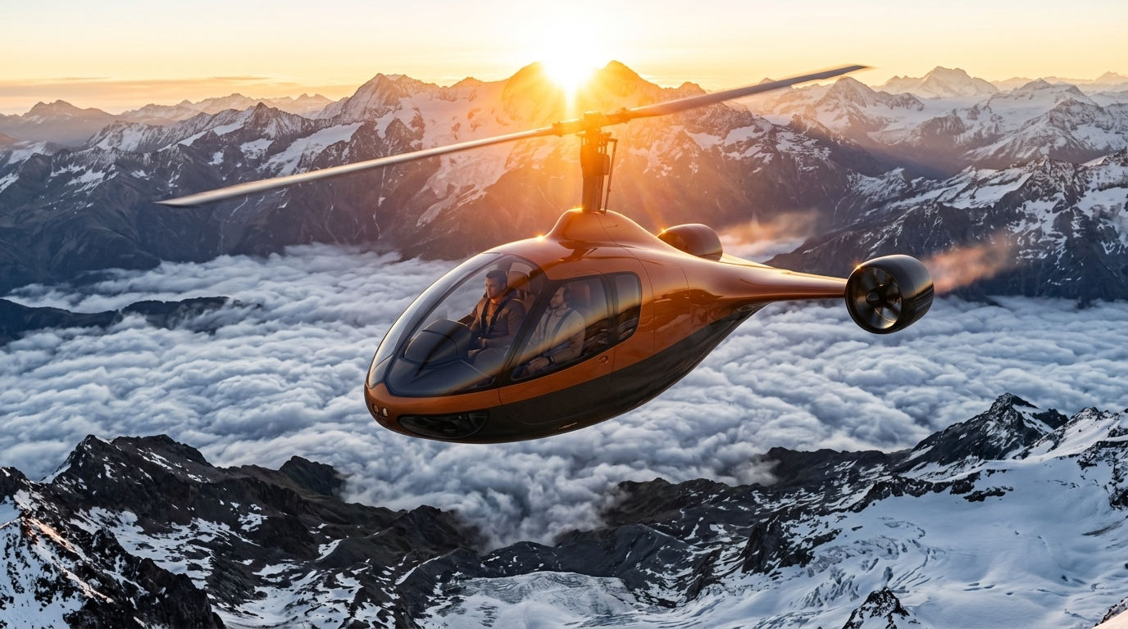
AIR ONE
Rajput Royale
The hybrid-electric autogyro for safe, fast regional flight
Investor presentation · [Month Year]
Notes:
Open on the aircraft itself. Air One Rajput Royale: a hybrid-electric autogyro built for safe, fast regional flight.

Slide 2
THE PROBLEM
Light rotorcraft carry three burdens
01
02
03
Mechanical complexity
Stall and power-loss risk
Tied to infrastructure
Powered main rotors, tail rotors and their gearboxes mean more parts, more inspections and more cost.
When the engine drives the rotor, losing power demands an instant, practised recovery from the pilot.
Operations depend on airfields and dedicated helipads, far from where people actually want to go.
AIR ONE · RAJPUT ROYALE
02
Notes:
Frame the gap: traditional rotary-wing aircraft are mechanically complex, carry stall and power-loss risk, and need specialised aviation infrastructure.

Slide 3
THE ANSWER: AN AUTOGYRO
A rotor that keeps flying when the power stops
The Rajput Royale's main rotor is never driven in flight. Air flowing up through it keeps it spinning in autorotation, so the aircraft stays controllable and can glide to a landing even after total power loss.
Notes:
This is the core safety argument. Because the rotor is always autorotating, it resists stall and remains controllable with no power at all. Avoid saying it "cannot stall": rotor blades can still stall, and reviewers will pick on it.

Slide 4
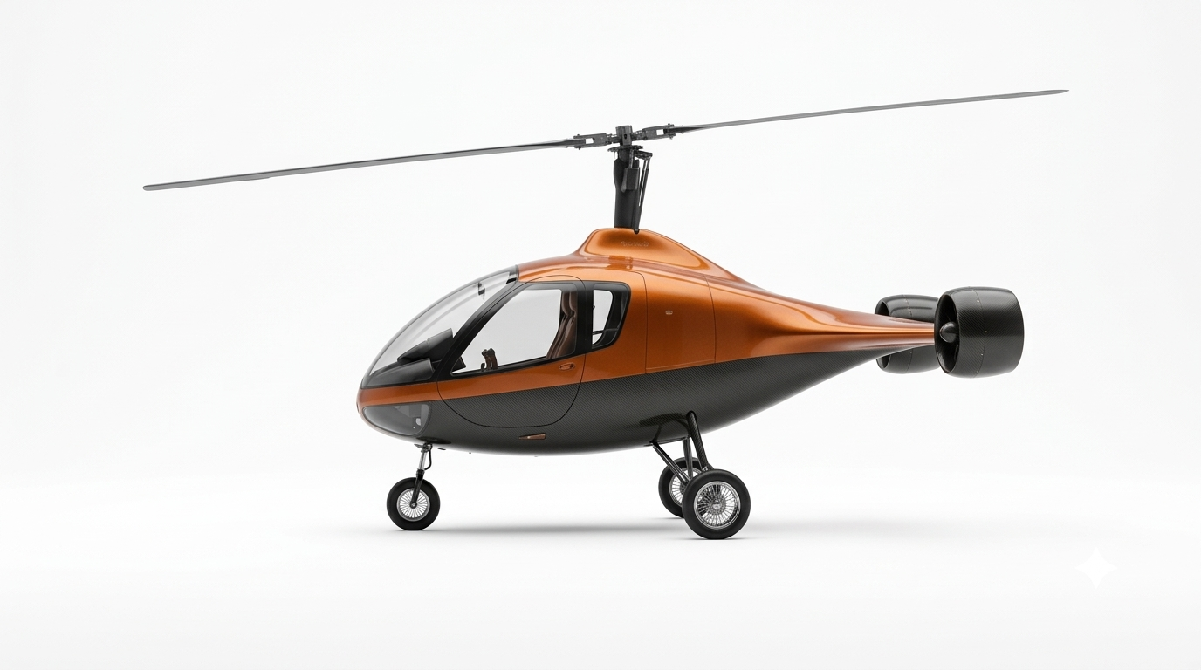
THE AIRCRAFT
Meet the Rajput Royale
Two-blade carbon rotor
Passive in cruise, with a Rotating Mass Balancer to damp vibration.
Twin ducted thrusters
The only source of forward thrust, shrouded for safety and low noise.
Tailless boat-tail
No vertical fin; vectored thrust keeps it pointed straight.
Tricycle landing gear
Steerable nose wheel and a wide-stance main gear.
AIR ONE · RAJPUT ROYALE
04
Notes:
Walk the four defining features: the balanced two-blade rotor, twin rear ducted thrusters, the tailless boat-tail and the tricycle gear. The fuselage is a carbon-fibre monocoque teardrop pod.

Slide 5
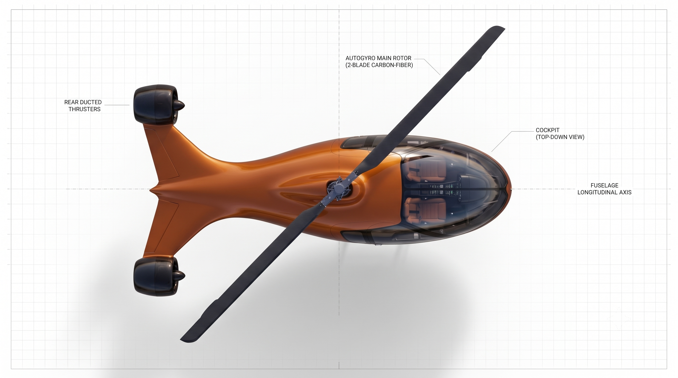
DESIGN INSPIRATION
Shaped by the swallow-tailed kite
The kite's forked tail became the Rajput Royale's twin swept aft pylons, each carrying a ducted thruster at its tip.
Swallow-tailed kite · Photo: Andy Morffew, Flickr (CC)
Rajput Royale · top plan view
AIR ONE · RAJPUT ROYALE
05
Notes:
The bird-inspired layout isn't only styling: the swept pylons place the thrusters in the fuselage wake, which enables the boundary-layer ingestion covered on the aerodynamics slide.

Slide 6
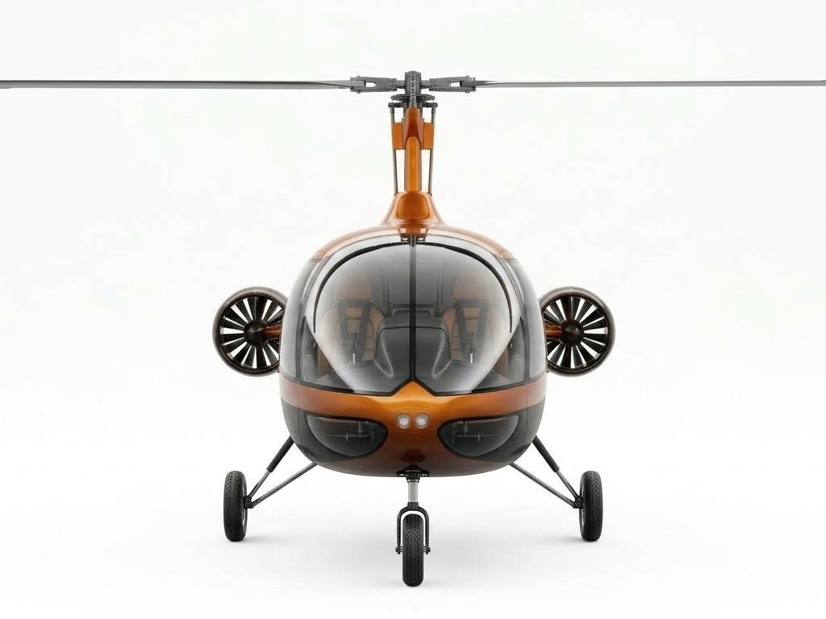
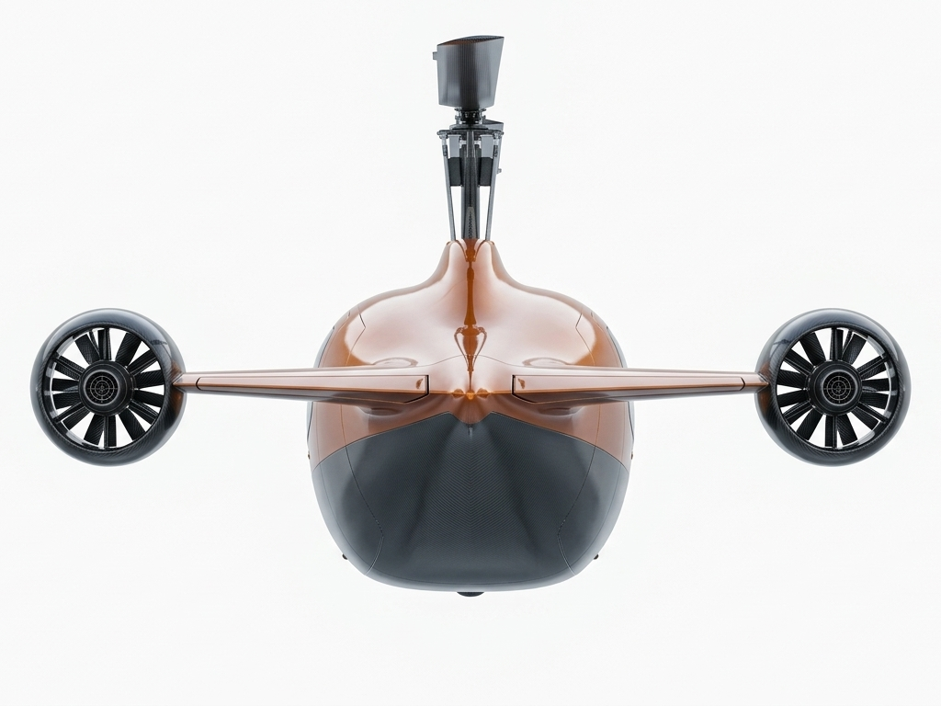
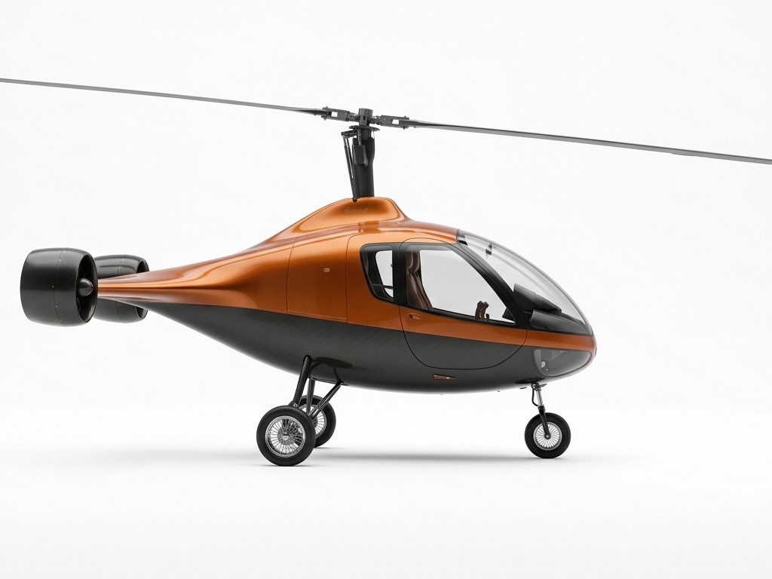
EVERY ANGLE
Clean flanks, no side fans, no tail fin
Front
Rear
Right side
AIR ONE · RAJPUT ROYALE
06
Notes:
The only propulsion is the pair of rear ducted thrusters. The cabin sides are completely clean, and there is no tail fin, tail boom or wing.

Slide 7
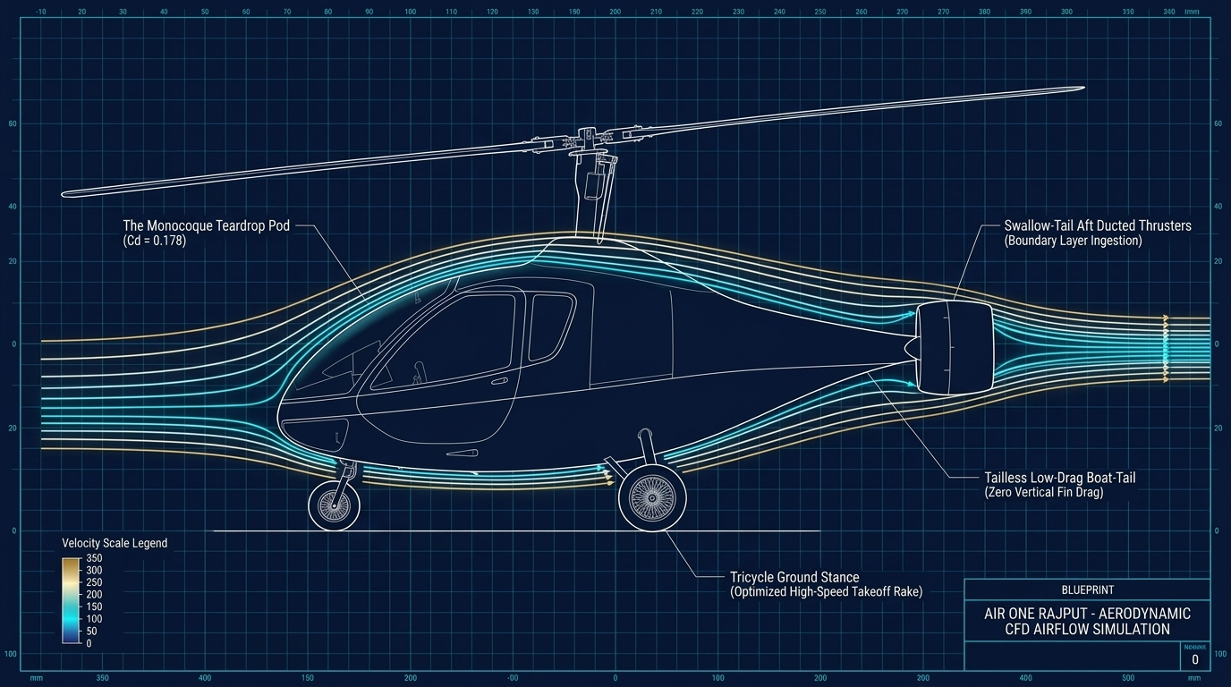
AERODYNAMICS
Built to slip through the air
0.178
Drag coefficient of the monocoque teardrop pod (CFD)
BLI
Thrusters ingest the slow wake air, cutting pressure drag
No fin
Tailless boat-tail removes fin drag and crosswind sensitivity
AIR ONE · RAJPUT ROYALE
07
Notes:
Low drag drives everything: every unit of drag saved lowers battery discharge and extends range. Flow separation is delayed until the aft-most fuselage. The takeoff rake of the tricycle stance sets the rotor at an ideal angle of attack for fast spin-up.

Slide 8
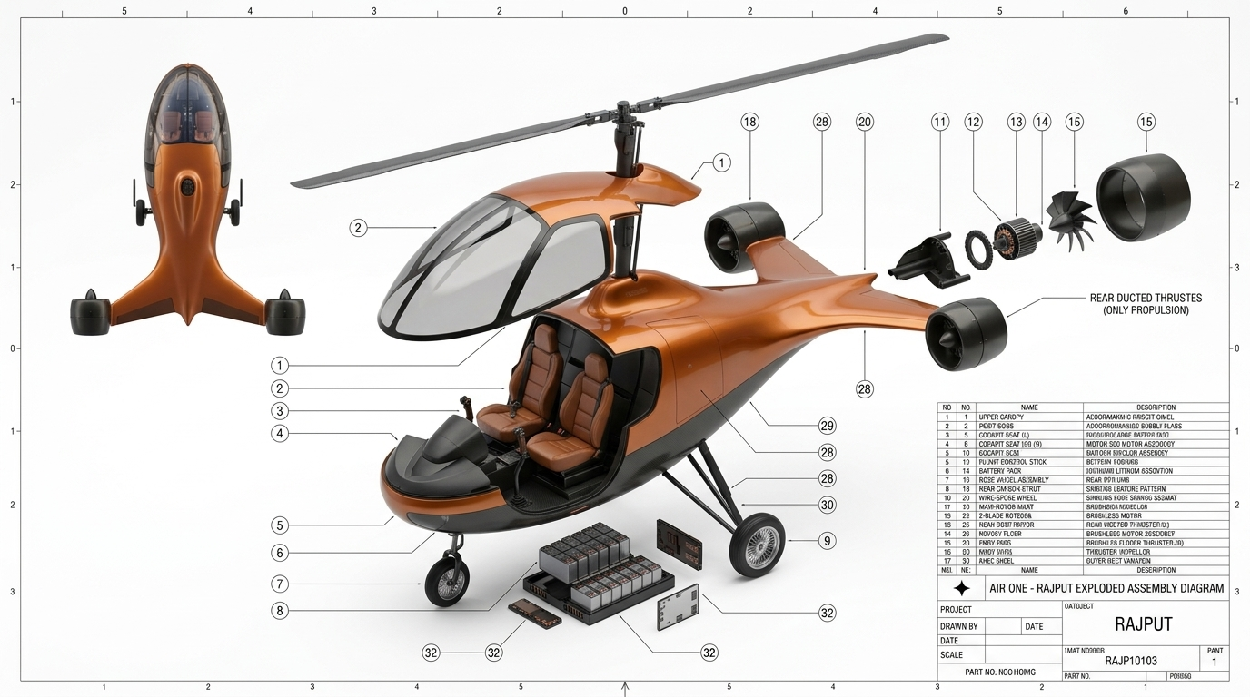
PROPULSION AND POWER
Electric thrust, hybrid range
Motor 500 Series BLDC
Two high-torque brushless motors drive all forward thrust.
Composite ducts
Shrouded impellers: no tip losses, less noise, protected from debris.
Battery plus generator
Battery bursts for takeoff; a hybrid unit holds charge in cruise.
Redundant by design
If one motor fails, fly-by-wire trims the thrust for a safe return.
AIR ONE · RAJPUT ROYALE
08
Notes:
The main rotor is unpowered in cruise and autorotates; the two rear thrusters are the sole source of forward thrust. The lithium-ion battery gives instant torque for takeoff, and the hybrid generator uses liquid fuel's energy density to sustain long-range cruise.

Slide 9
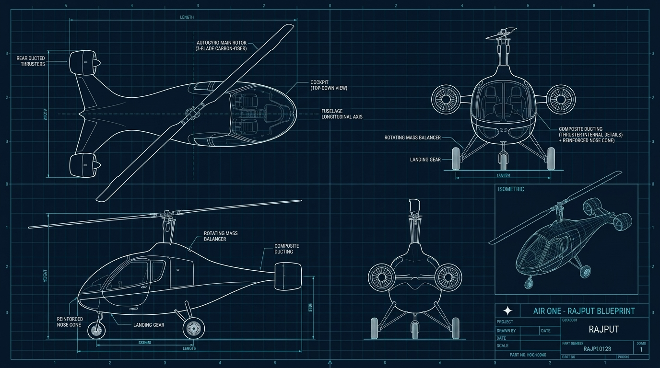
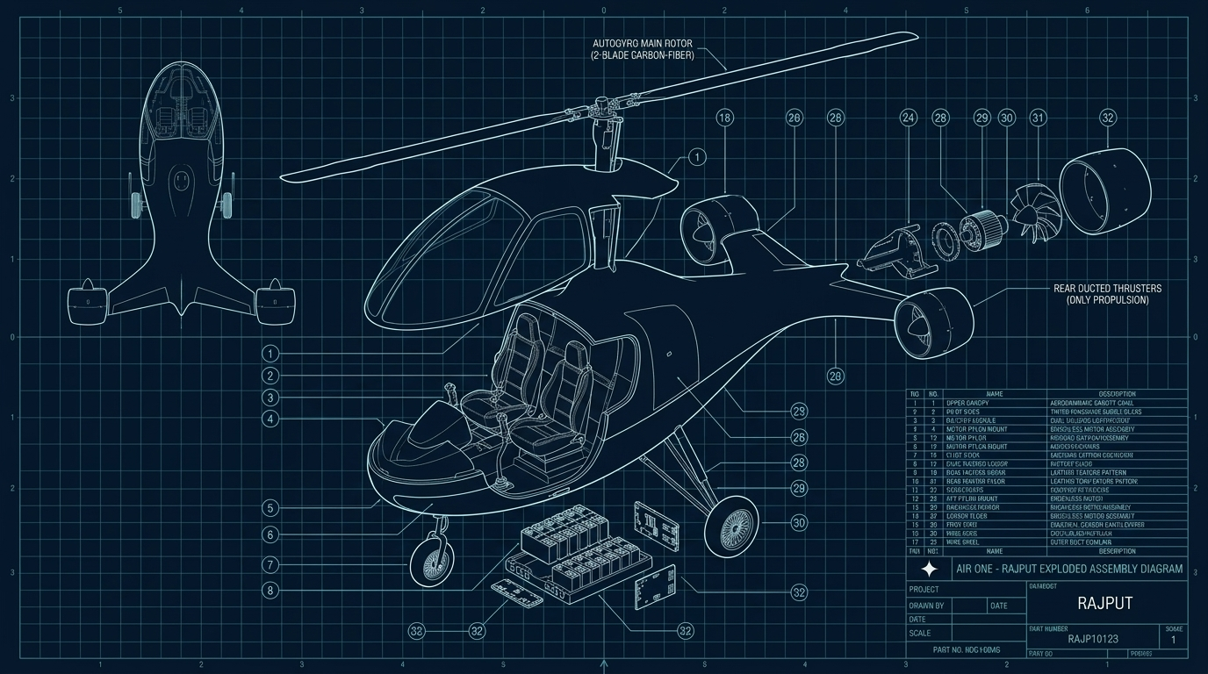
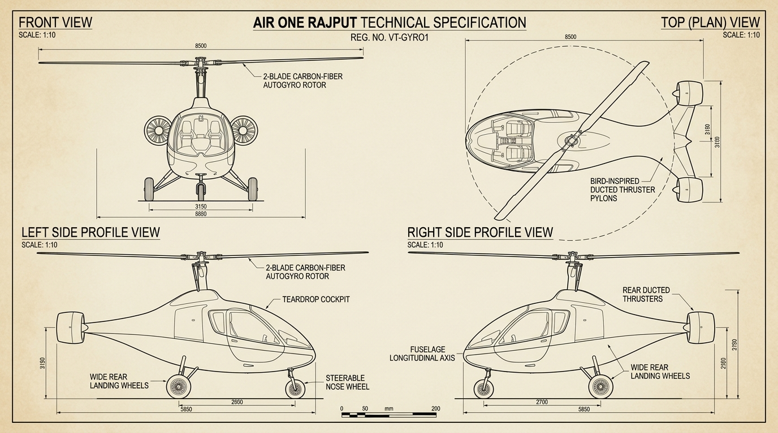
ENGINEERING PACKAGE
Drawn, exploded and specified
AIR ONE · RAJPUT ROYALE
09
Notes:
Four-view orthographic blueprint, exploded assembly with parts list, and a 1:10 technical sheet. These are concept visualisations; say so if asked whether they are certified engineering drawings.

Slide 10
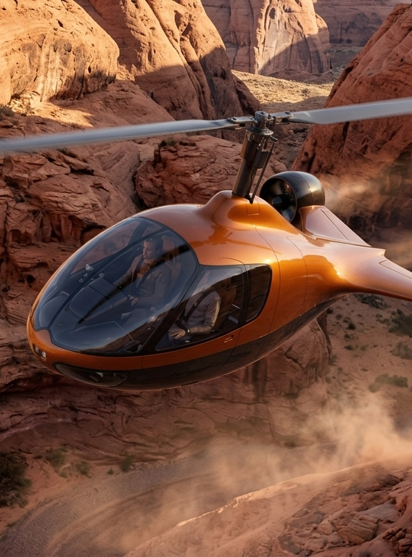
PERFORMANCE TARGETS
Helicopter reach, lower running cost
300
600
km/h cruise speed
km range per sortie
20,000
VTOL
ft service ceiling
launch and recovery
AIR ONE · RAJPUT ROYALE
10
Notes:
Design targets from the technical report. High-altitude tailwinds at the 20,000 ft ceiling can stretch range on ferry flights. Be ready for two questions: an unpowered-rotor autogyro normally needs a pre-rotated "jump" takeoff rather than true VTOL, and an unpressurised cabin needs oxygen above about 12,500 ft.

Slide 11
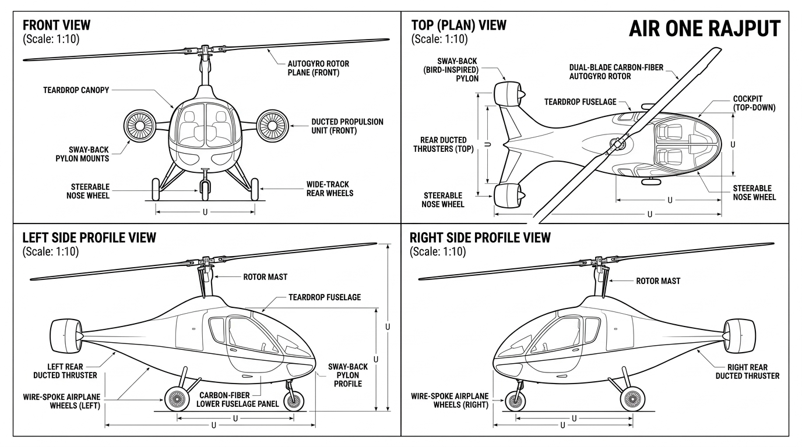
SPECIFICATIONS
Light, compact, half its weight free
Parameter | Value
Rotor span | 8,500 mm
Fuselage length | 5,850 mm
Height | 3,150 mm
Wheel track | 3,150 mm
Wheelbase | 2,600–2,700 mm
Max takeoff weight | 500 kg
Empty weight | 230–270 kg
Payload and fuel | up to 270 kg
AIR ONE · RAJPUT ROYALE
11
Notes:
Empty weight is about half of MTOW, so operators can trade passengers against fuel and battery for longer sorties. Double-check that height and wheel track really are both 3,150 mm before presenting.

Slide 12
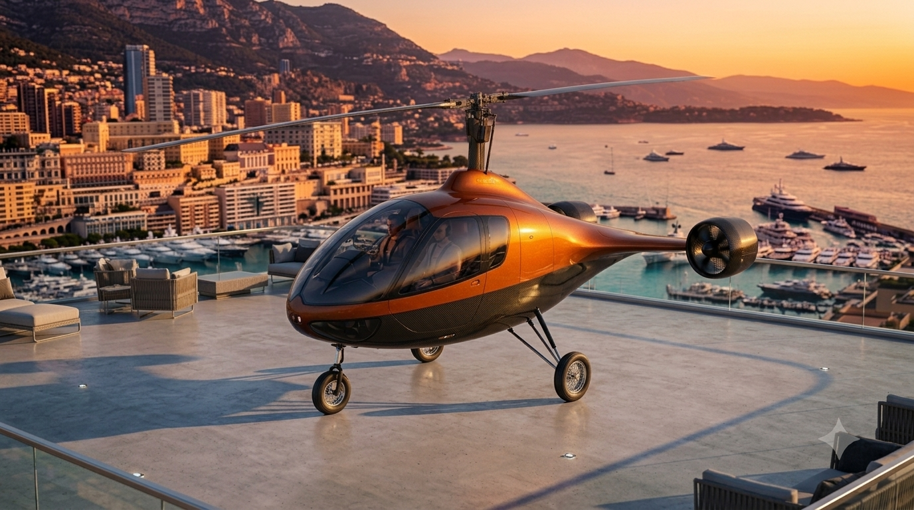
INFRASTRUCTURE
Lands on rooftops, estates and vertiports
5.85 m long
3.15 m wheel track
8.5 m rotor span
AIR ONE · RAJPUT ROYALE
12
Notes:
The compact footprint lets it operate from private estates, rooftop pads and urban vertiports with minimal changes to the ground site. I left out the report's "fits a standard parking space" claim: a 3.15 m track is wider than a typical 2.5 m bay.

Slide 13
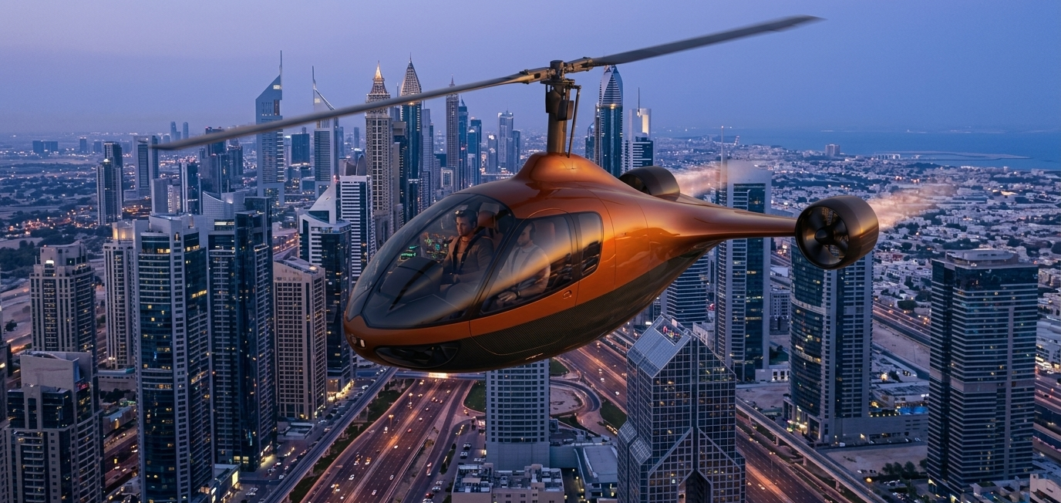
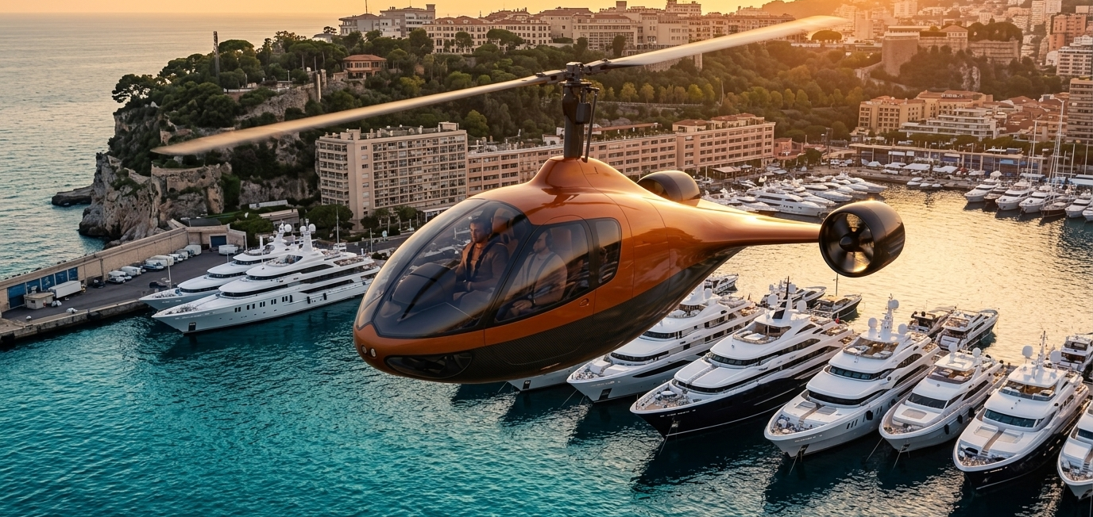
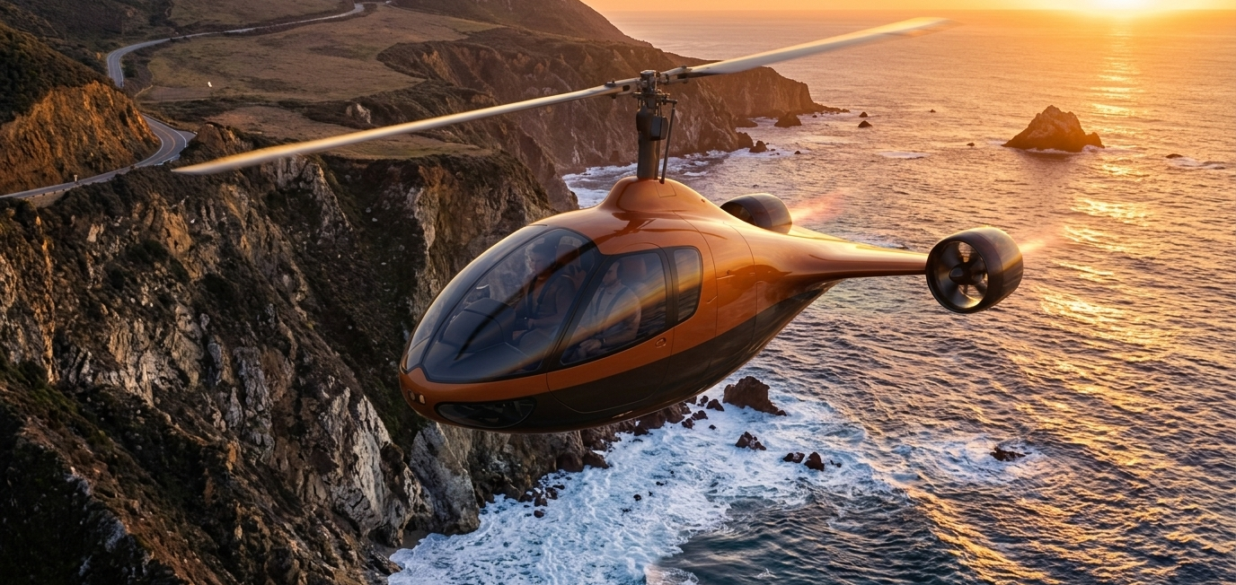
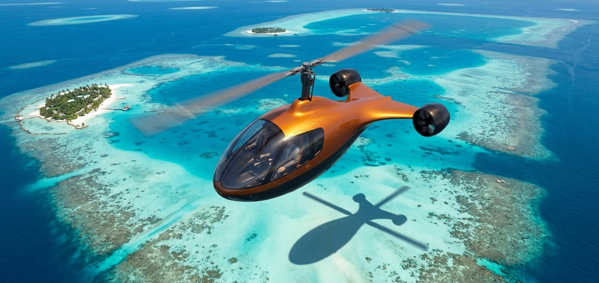
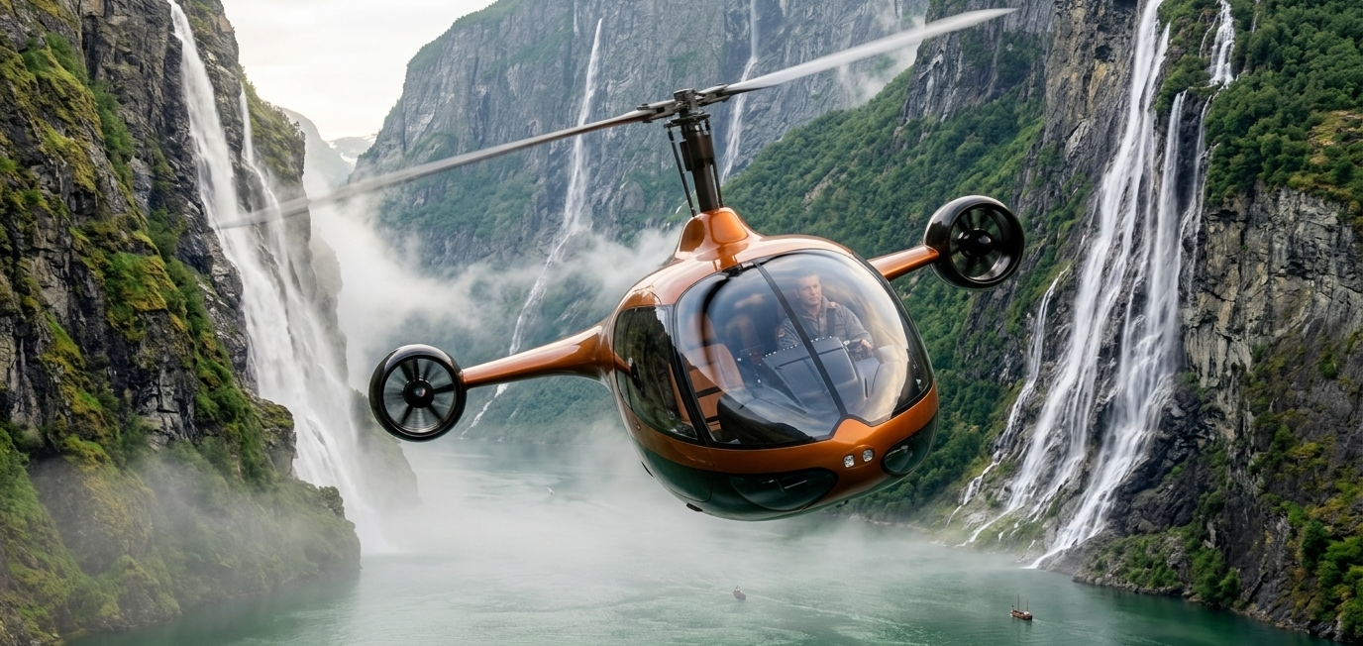
MISSIONS
One aircraft, many missions
Urban vertiport hops
Private and luxury travel
Coastal and regional ferry
Island hopping
High-altitude mountain
Remote and scenic tours
AIR ONE · RAJPUT ROYALE
13
Notes:
Urban vertiports, private estates, regional ferry flights, island hopping and high-altitude mountain work, all from one airframe.

Slide 14
MARKET AND BUSINESS MODEL
Who buys it, and how we earn
Customers
Market size
Revenue
[Private owners, charter and tourism operators, island and mountain transport, public services]
[$__ B]
[Unit price $__ · service and maintenance plans · pilot training · fleet leasing]
[TAM · SAM · SOM, with source]
AIR ONE · RAJPUT ROYALE
14
Notes:
Placeholders: fill in customer segments, market size with a cited source, and pricing.

Slide 15
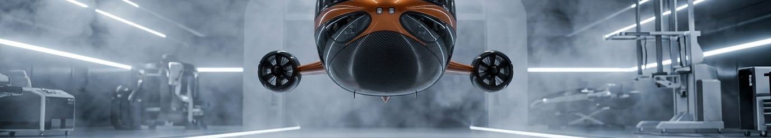
ROADMAP
From concept to first delivery
[Q_ 20__]
[Q_ 20__]
[Q_ 20__]
[Q_ 20__]
Concept and CFD design
Prototype build
Flight testing
Certification and deliveries
AIR ONE · RAJPUT ROYALE
15
Notes:
Placeholders: add dates and the status of each stage, and name the certification path you are targeting.

Slide 16
TEAM
The people building it
[Name]
[Name]
[Name]
Founder and CEO
CTO
[Role]
[One line of relevant background]
[One line of relevant background]
[One line of relevant background]
Advisors: [Names and affiliations]
AIR ONE · RAJPUT ROYALE
16
Notes:
Placeholders: founders, key engineers and advisors, each with one line on why they can build this.

Slide 17
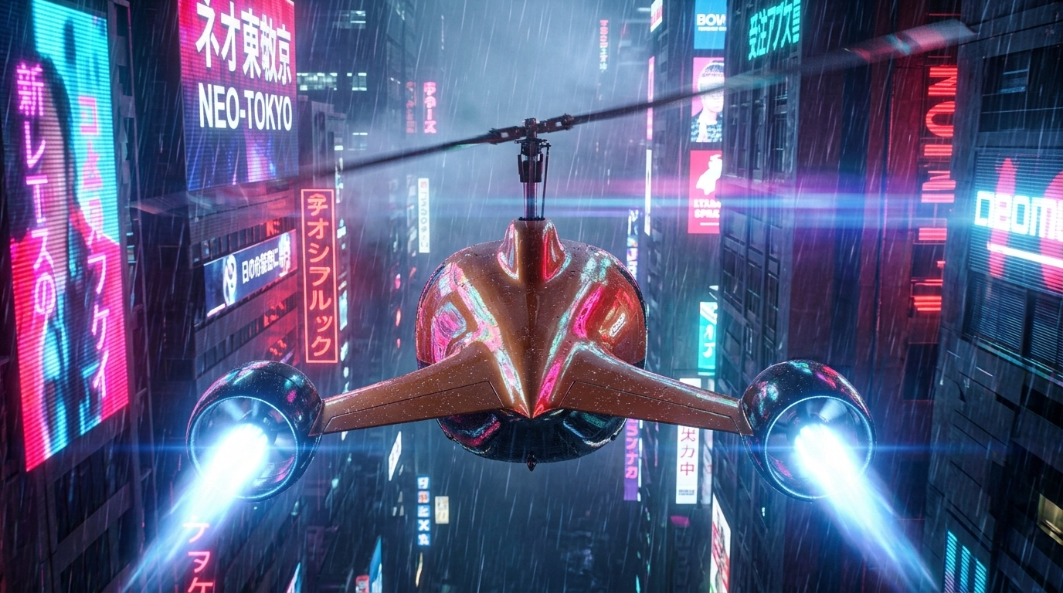
THE ASK
Raising [$__] to fly the first Rajput Royale
[__%] Prototype
[__%] Flight testing
[__%] Certification
[__%] Team
AIR ONE · RAJPUT ROYALE
17
Notes:
Placeholders: round size, the milestone it funds, and the use-of-funds split.

Slide 18
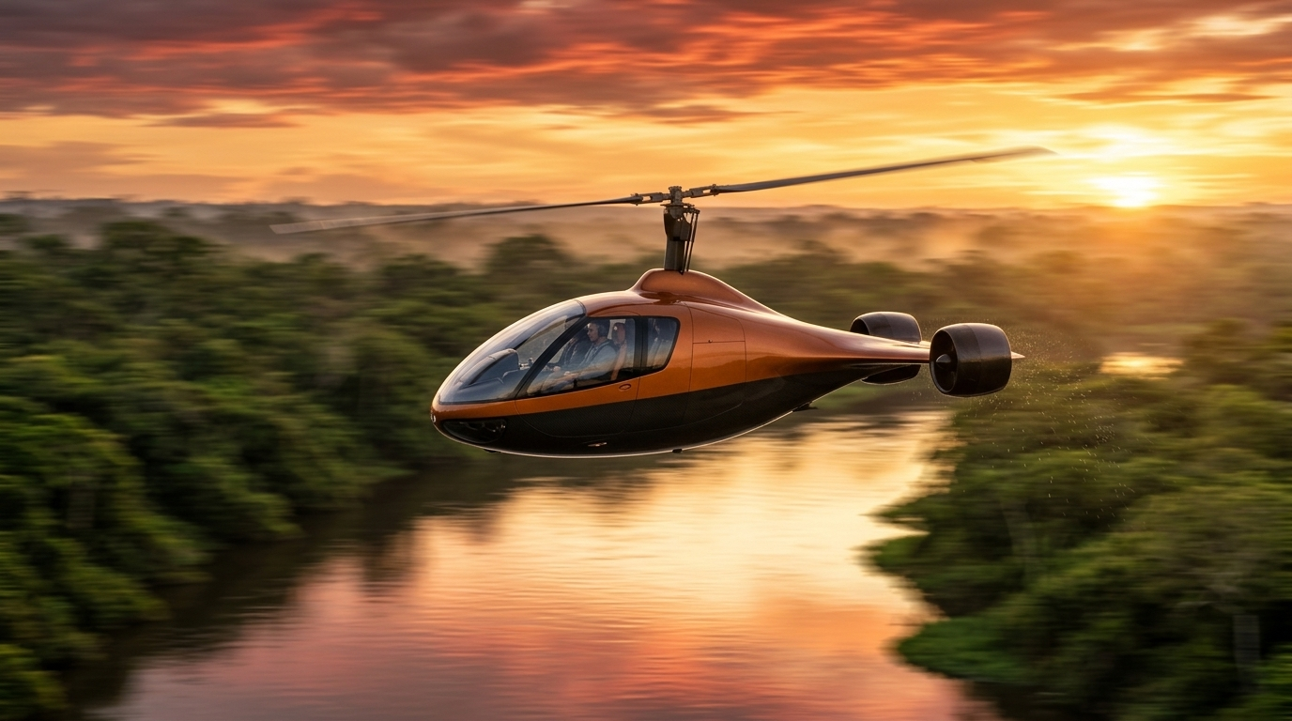
AIR ONE · RAJPUT ROYALE
Thank you
[Name] · [email] · [website]
Notes:
Close and open for questions.

